Slide 1


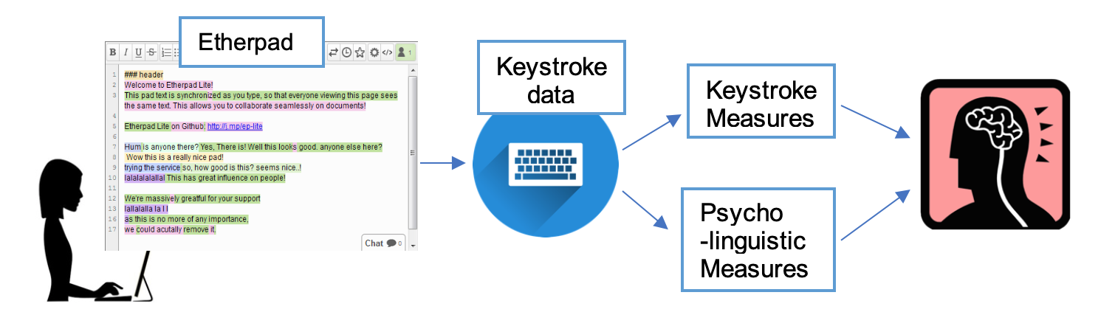
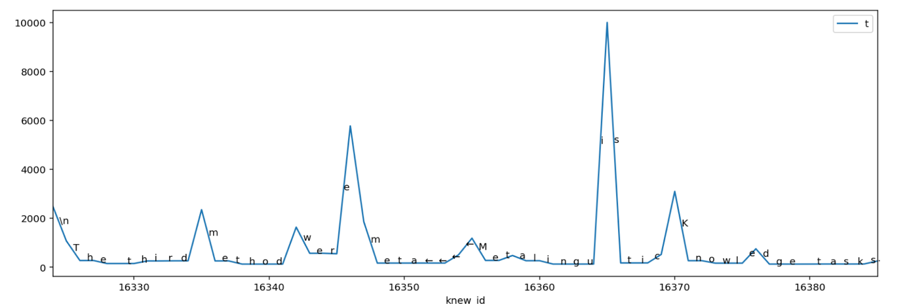
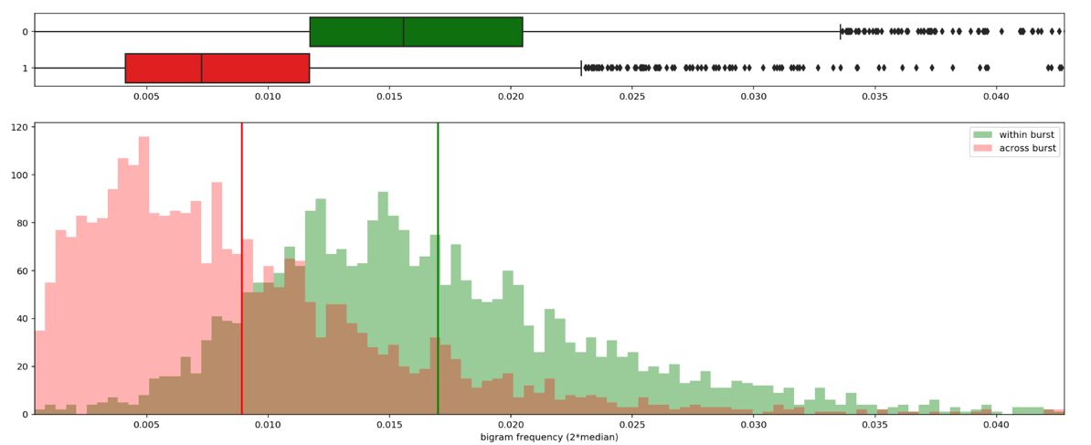
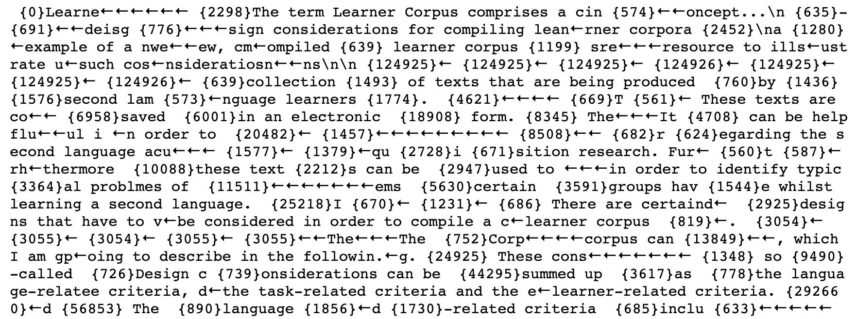
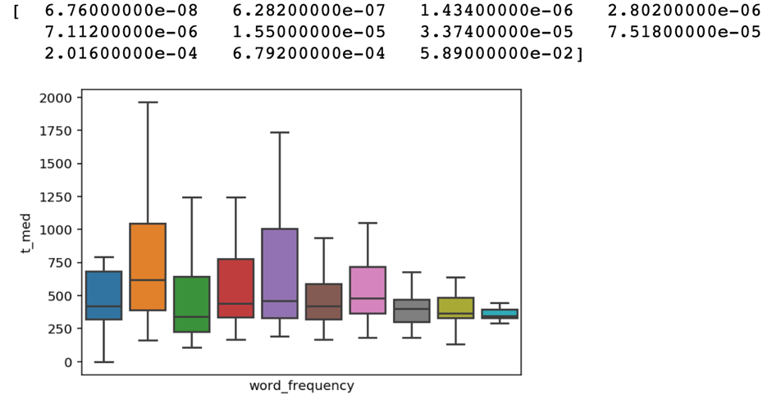
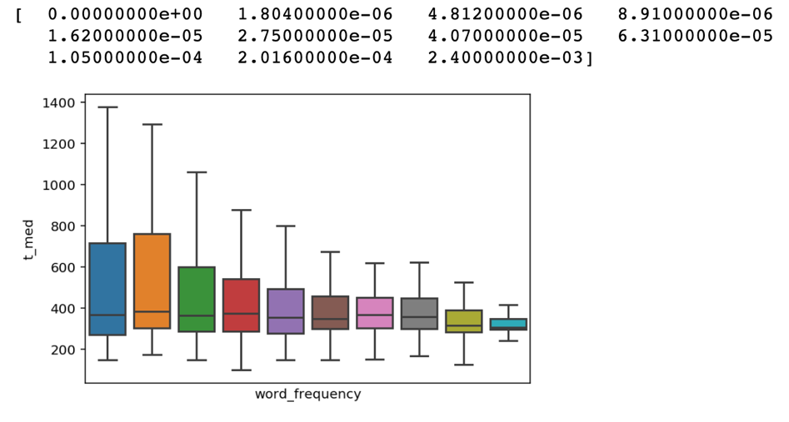
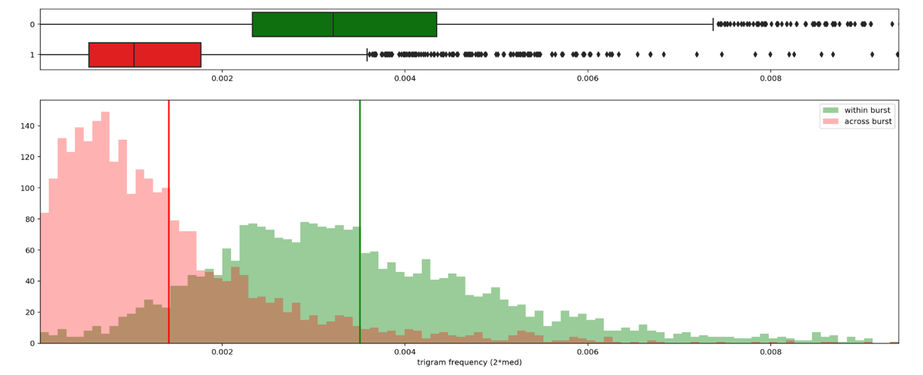
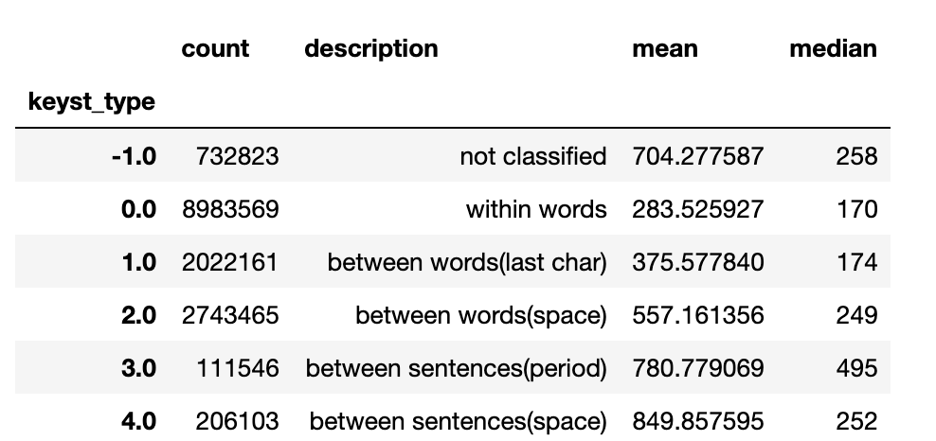
Keystroke Logging in Second Language Writing Research
Joo Hyun Lee, Elma Kerz & Marcus Ströbel
Introduction
Discussion
Understanding human’s key literacy skill has been an important but a challenging topic in many different fields such as linguistics, education, and cognitive science. Many researchers have been particularly interested in finding the cognitive process lying behind the writing process. As keyboard writing emerged recently, keystroke logging has provided a new insight in understanding the cognitive process in writing. Commonly used measures are pauses between keystrokes, burst (consecutive keystrokes without pause), and revision (Alves, 2008; Baaijen, 2012; O’Brien, 2006; Miller, 2008).
We expect to see how cognitive efforts are embedded in the keystroke logging data. To achieve this, there are several challenges. First of all, the large amount of data must to be cleaned and turned into a form that is easily manipulatable. Second, appropriate keystroke measures that can be applied to the database must be chosen. Third, psycholinguistic measures that represents the cognitive effort that is achievable from the data should be found. Lastly, the relationship between the keystroke measures and the psycholinguistic measures needs to be found.
As expected, as word frequency increased the time taken to type the words decreased. However, it was interesting that this effect is less clear when the length of the word is short. This may imply that when the word length is short, the writer does not take additional time to think about and write a more unfamiliar word. The relationship between n-gram frequency and the pause length show that people generally type without pausing when writing more frequent bigrams and trigrams. Both findings were meaningful because we could see that the chunk-based process also happens in keyboard writing.
Methods
Word Frequency
N-gram Frequency and Bursts
660 students wrote around 5 to 10 texts, each summarizing a linguistics lecture content, over a semester. We had an Etherpad change sets of text files approximately 3 GB in size in total. For each change set file, there was the corresponding text file the student wrote. Each Etherpad change set contained information of each keystroke. Since the change sets were not easy to comprehend and accessible, only the necessary information was extracted and converted into CSV form. Pandas dataframe called ‘keystrokes’ was created to easily access the information. The position of the keystrokes in the final text was calculated by keeping track of the current position for every keystroke. Words, sentences, files, users dataframe were also created.
Before bigram/trigram frequency and bursts were compared, we wanted to see the relationship between word frequency and pause length. Word frequency (from COCA - academic) and pause length were compared. Only the words with same length and no spelling errors were compared. Also, the number of occurrence of words in the data and pause length were compared.
First, the list of bursts using the different pause thresholds were retrieved. Appropriate pause thresholds (2*median of pause threshold, 550ms, 1000ms, and 2000ms) were chosen by looking into the burst visualization and also referring to related papers. Then, the n-gram frequency (in log scale) within a burst and across bursts were compared. These steps were executed for all the sentences and different pause thresholds. The histogram and the means of two groups (within burst, across bursts) were observed.
Keystroke Measure | Name
t | Pause length
t_filiter_10000 | Pause length filtered (10000ms)
avg_burst _len | Average Burst Length
within_burst | Within/across burst
Psycholinguistic Measure | Description
Word frequency | Word frequency in scale 0 to 1
n-gram frequency | N-gram frequency in scale 0 to 1
Occurrence | Occurrence of words in data
N-gram Frequency and Bursts
Visualization of Bursts
Result
Statistics
In all of the cases, the n-gram frequency was significantly higher for the n-grams within burst (green) than across burst (red).
Statistics | Value
Word Per Minute (t_filter_2000) | 24.66
Word Per Minute (t_filter_10000) | 18.56
Average Sentence Length (characters) | 118.46
Average Sentence Length (words) | 19.21
Average Word Count in each text file | 530.41
Average time spent on each character (t_filter_10000) | 379.30ms
Median time spent on each character (t_filter_10000) | 174ms
Average time spent on each character (t_filter_2000) | 274.34ms
Median time spent on each character (t_filter_2000) | 172ms
Word Frequency and Pause Length
Different Keystroke Types
As shown below, generally the median pause length decreased when the word frequency was higher. The effect was less evident when the word length was small, especially when smaller than 4.
The time (pause) taken between different types of keystrokes were compared.
Bigram Frequency (2*median pause length) within vs across burst
Word frequency and Median Pause Length (word length = 3)
Word frequency and Median Pause Length (word length = 5)
Trigram Frequency (2*median pause length) within vs across burst

